Slide 1
WingTipTickets
Azure SQL Database & Azure Search HOL V2.1
https://github.com/guyhay/WingTipTickets

Slide 2
Hands-on-lab intro
What you need
A paid Azure account, either your own or using an Azure Pass from Guy
One of the VMs with the client tools RDP instructions https://www.yammer.com/azureadvisors/#/groups/6200653/files
Instructions and files for the HOL C:\WingTipTickets
Tasks to-do this morning
Ensure that you can login to http://portal.azure.com
Ensure that you can connect to the VM (wingtipseptdatacamp.cloudapp.net:63907)
Start the provisioning process for the HOL C:\WingTipTickets

Slide 3
Azure demo
http://portal.azure.com
Azure SQL Database create DB
Connect from SSMS

Slide 4
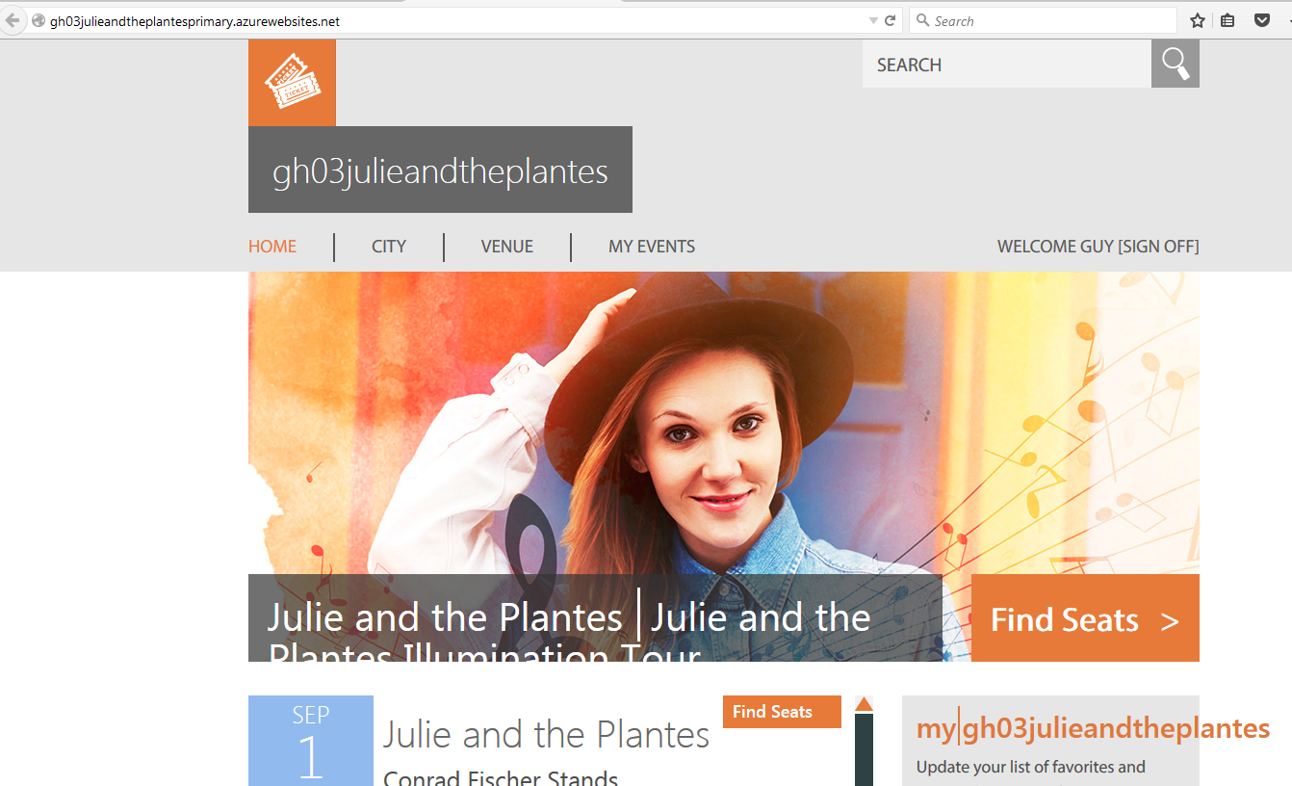
http://gh03julieandtheplantesprimary.azurewebsites.net/

Slide 5
WTT Architecture in your subscription
Region A
Traffic Manager
Region A
Primary
Azure WebApp
Primary Customer Database
Tables:
Concerts
Customers
Tickets
Venues etc
Geographic Replication
Region A
Secondary
Azure WebApp
Secondary Customer Database
Tables:
Concerts
Customers
Tickets
Venues etc
Region B optional

Slide 6
Azure SQL DB demo
Delete DB
Restore DB
Load Generator

Slide 7
HOL Setup Steps
Connect to your VM and navigate to C:\WingTipTickets
https://www.yammer.com/azureadvisors/#/groups/6200653/files has the connection files
Launch Azure PowerShell (as an administrator)
Add-AzureAccount
Optional - Select-AzureSubscription –SubscriptionId <provide your subscription that you want to use>
Set-ExecutionPolicy -Scope LocalMachine -ExecutionPolicy Unrestricted –Force
Switch to the directory C:\WingTipTickets\scripts
Unblock-file .\New-WTTEnvironment.ps1
. .\New-WTTEnvironment.ps1
New-WTTEnvironment -WTTEnvironmentApplicationName xx00julieandtheplantes

Slide 8
Add-AzureAccount
Select-AzureSubscription –SubscriptionId ba047a9f-de49-4f4d-80fd-b21baf9aa67a
Set-ExecutionPolicy -Scope LocalMachine -ExecutionPolicy Unrestricted –Force
Cd c:\WingTipTickets\Scripts
Unblock-file .\New-WTTEnvironment.ps1
. .\New-WTTEnvironment.ps1New-WTTEnvironment -WTTEnvironmentApplicationName gh03julieandtheplantes

Slide 9
Demo scenarios and pre-reqs
Feature | Story | How
 | Connect via SSMS to verify DBs
Ticket purchase | Show that sample application | Navigate to http://gh01julieandtheplantes.trafficmanager.net/
Vertical Scaling | Anticipation of a big name artist in a specific city | Portal: change service-tier or performance level
Horizontal Scaling (Elastic & Geo scale) | Anticipation of a big name artist country wide with sale on same day | Portal: show shards (databases) ( VS: show multi-shard query and associated sharp map (cities) and data dependent route (city)
Auditing | Key Arena DB mysteriously vanished | Portal: show the operation to enable and setup Auditing for a specific DB; auditing dashboard VS: show security-enabled connection string, and change the password Portal: Delete the Venue DB Web site: show missing Key Arena venue Excel: show dashboard – show who deleted the DB
Point-in-time restore | Accidental DB deletion | Portal: restore a point in time backup Web site: show there’s still an error after restoring the Venue DB because of the incorrect password Excel: show dashboard – show the spike in login failures because of incorrect password VS: correct the password Web site: show that all is working with the restored Venue DB
Geographic disaster recovery | Server in a datacenter goes down | Portal: increase the size of the DB instance from S to P1 (since active-geo is only available in P instances) Portal: show how traffic manager is setup to redirect traffic to a hot standby of the web tier Portal: shutdown the primary web tier VM Portal: show how a geo replicated secondary can make available a hot standby of the data tier Portal: stop replication to the secondary, which effectively promotes to secondary to a primary Web site: show how the site continues to run without interruption
Predictable performance across service tiers and performance levels | Am I using the right service/performance tier (SKU) based on my usage? | SSMS: show the dynamic management view, which uses historical consumption data to recommend the right service tier/performance level
Workload insights | What if I want an automated way to assess my historical usage and recommend DB size, SKU size, expected usage etc? | Portal: From Workload Insights, show how a poor performing Index has been identified and hints appear to recommended index optimization.
An Azure account
If you don’t already have an Azure Account, browse to http://azure.microsoft.com/en-us/pricing/free-trial/
Installation of Visual Studio
If you don’t already have Visual Studio installed
Installation of ‘Microsoft Azure Powershell’ and Azure SDK
Browse to http://azure.microsoft.com/en-us/downloads/
Under Command-line Tools, Windows PowerShell, select Install
Under SDKs, .NET, select the VS specific installation based on your version of Visual Studio
Deployment Scripts & load generator
Demo script & deployment guide

